Slide 1

S&P 500 Stock Price Prediction using LSTM
Brian HODGSON

Slide 2
MotiVATIOn
Using LSTM (Long Short-Term Memory) networks for S&P 500 stock prediction offers a compelling advantage due to LSTM's ability to handle time-series data, capturing both short-term patterns and long-term dependencies, which are essential for financial forecasting.
The primary objective of the stock prediction using LSTM is to forecast future prices or trends in the stock market (objectives can be)
Short Term prediction
Long Term prediction
Risk management
Market analysis
1. Capturing Temporal Dependencies
Stock prices are sequential, influenced by past movements, trends, and events. Unlike traditional neural networks, LSTM networks are designed to retain information across time steps, effectively learning from both recent and historical data. This ability to remember previous information over long sequences is crucial for predicting stock prices, where short- and long-term patterns both matter.
2. Handling Non-Stationary Data
Financial markets are highly volatile, with non-stationary data affected by macroeconomic factors, news, and investor sentiment. LSTMs are robust to such variations, adapting to changes over time and capturing complex, non-linear relationships within the data. This flexibility makes LSTM models more adept at identifying and responding to shifting market conditions

Slide 3
MotiVATIOn
ANALYSIS OF WORK
3. Reducing the Risk of Overfitting
LSTM’s internal memory mechanism selectively retains or forgets information, helping the model focus on relevant data points without relying too heavily on noise. This is particularly important in stock price prediction, where spurious patterns can mislead simpler models into overfitting. The selective memory of LSTMs enhances their generalization ability, reducing the risk of overfitting on volatile stock data.
4. Incorporating Multiple Inputs for a Holistic View
Stock prices are influenced by a variety of features, such as past prices, trading volume, macroeconomic indicators, and market sentiment. LSTM models can incorporate these multiple input features over time, creating a richer, more holistic model that combines diverse sources of information. This leads to more accurate predictions by factoring in complex interactions.
5. Proven Effectiveness in Financial Time-Series Prediction
LSTM networks have been widely used in financial applications with success in capturing price trends, volatility, and market cycles. Their application in stock prediction aligns well with research showing that LSTMs outperform many traditional and other machine learning models in time-series tasks, especially for data with long-term dependencies like stock prices.

Slide 4
BESCHREIBUNG Der Daten / Description of The Data
Key Columns in Yahoo Finance S&P 500 Data
Date
Description: The specific date for each record.
Format: YYYY-MM-DD.
Example: 2024-11-06.
Open
Description: The price at which the S&P 500 index opened on that particular day.
Type: Float (e.g., 4392.56).
Example: 4400.22.
High
Description: The highest price reached by the S&P 500 during that day.
Type: Float.
Example: 4412.83.
Low
Description: The lowest price reached by the S&P 500 during that day.
Type: Float.
Example: 4385.12.
Close
Description: The final price at which the S&P 500 closed on that day. This is often used as the main metric for analysis.
Type: Float.
Example: 4408.45.
Adj Close
Description: The closing price adjusted for corporate actions like dividends, stock splits, etc. It provides a better historical comparison.
Type: Float.
Example: 4408.45.
Volume
Description: The total number of shares traded during that day. For indices like the S&P 500, this reflects the combined trading volume of the component stocks.
Type: Integer.
Example: 3500000000 (3.5 billion shares).

Slide 5
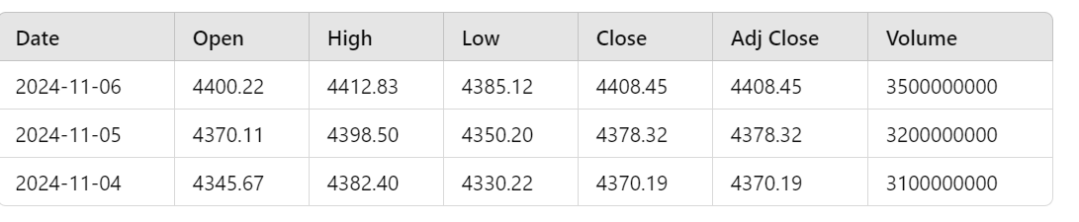
BESCHREIBUNG Der Daten / Description of The Data
Typical Data Usage in Modeling
Date: Used as the index for time-series analysis.
Close and Adj Close: Commonly used for predictive modeling and analysis.
High, Low, Open: Sometimes used for calculating indicators like daily range, volatility, or candlestick patterns.
Volume: Used as an additional feature to understand trading activity, which can indicate market sentiment.

Slide 6
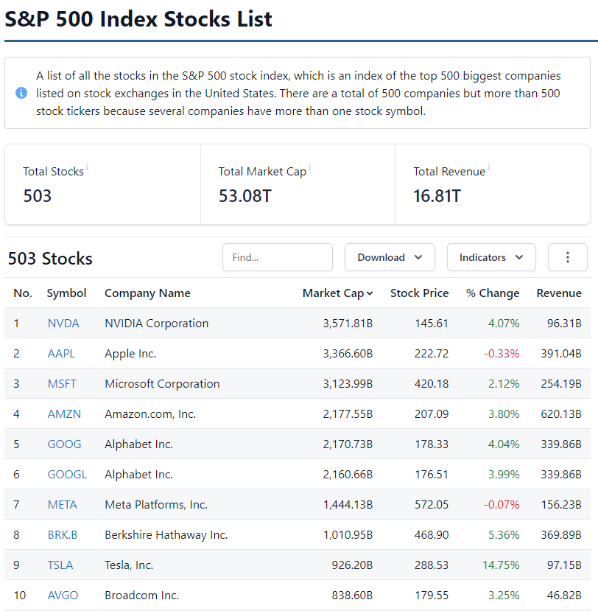
BESCHREIBUNG Der Daten / Description of The Data

Slide 7
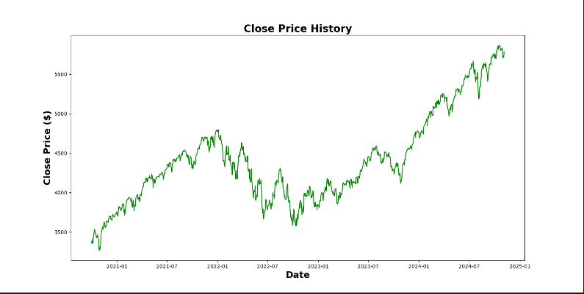
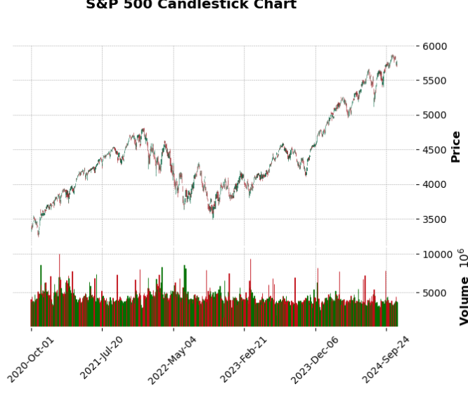
BESCHREIBUNG Der Daten / Description of The Data

